Slide 1

Artificial Intelligence Technologies
Search Techniques & Games II
By Hu Wang

Slide 2
Search Techniques

Slide 3
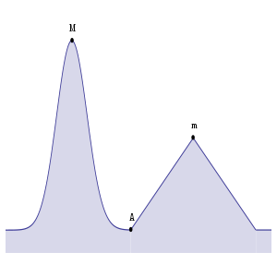
What is search techniques
How to find the maximum solution? Optimization is commonly seen in our daily lives.

Slide 4
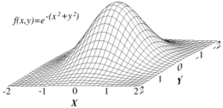
What is search techniques
How to find the maximum solution? Optimization is commonly seen in our daily lives.

Slide 5
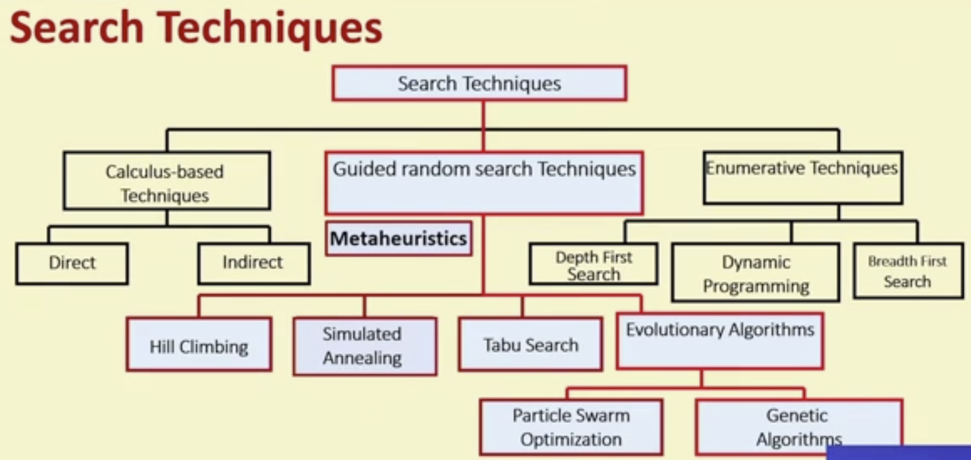
Search Techniques

Slide 6
Greedy Algorithm

Slide 7

Greedy Algorithm
Notes:
贪心算法，又名贪婪法，是寻找最优解问题的常用方法，这种方法模式一般将求解过程分成若干个步骤，但每个步骤都应用贪心原则，选取当前状态下最好/最优的选择（局部最有利的选择），并以此希望最后堆叠出的结果也是最好/最优的解。{看着这个名字，贪心，贪婪这两字的内在含义最为关键。这就好像一个贪婪的人，他事事都想要眼前看到最好的那个，看不到长远的东西，也不为最终的结果和将来着想，贪图眼前局部的利益最大化，有点走一步看一步的感觉。}

Slide 8
Greedy Algorithm
Starting from A, a greedy algorithm that tries to find the maximum by following the greatest slope will find the local maximum at "m", oblivious to the global maximum at "M".

Slide 9
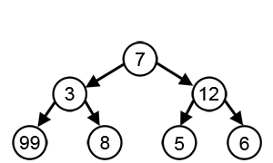
Greedy Algorithm
With a goal of reaching the largest sum, at each step, the greedy algorithm will choose what appears to be the optimal immediate choice, so it will choose 12 instead of 3 at the second step, and will not reach the best solution, which contains 99.

Slide 10
Greedy Algorithm --- Steps
Step 1: Start from an initial solution;
Step 2: An iterative process: In a sub-task, take steps to maximize your own profits, and reduce the scale of the problem;
Step 3: Combine all the sub-solutions.

Slide 11
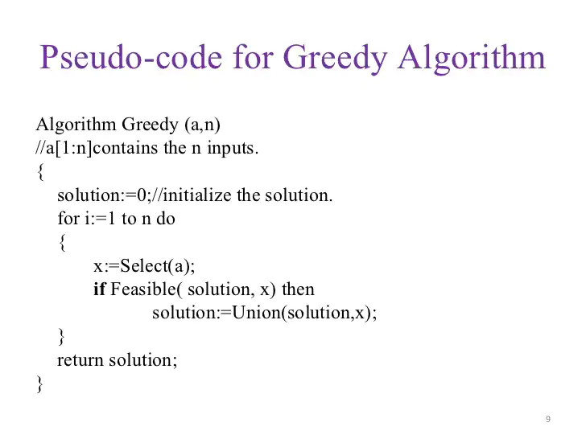

Slide 12
Greedy Algorithm --- Have a think
Suppose you have opened a small store and cannot pay electronically. The currency in the cash drawer is only 25 cents, 10 cents, 5 cents and 1 cent. If you are a salesperson and looking for coins of 41 cents to customers, how can you arrange them to let the money for the customer is correct and the number of coins is the least?
Here are a few points that need to be clear:
The currency has only four types of coins: 25 cents, 10 cents, 5 cents and 1 cent;
Find correct coins of 41 cents for the customer;
Minimize the number of coins

Slide 13

Greedy Algorithm --- Have a think
Suppose you have opened a small store and cannot pay electronically. The currency in the cash drawer is only 25 cents, 10 cents, 5 cents and 1 cent coins. If you are a salesperson and looking for coins for 41 cents to customers, how can you arrange them to let the money for the customer is correct and the number of coins is the least?
Could this problem be solved by Greedy Algorithms?

Slide 14


Greedy Algorithm --- Have a think
Suppose you have opened a small store and cannot pay electronically. The currency in the cash drawer is only 25 cents, 10 cents, 5 cents and 1 cent coins. If you are a salesperson and looking for coins for 41 cents to customers, how can you arrange them to let the money for the customer is correct and the number of coins is the least?
Could this problem be solved by Greedy Algorithms?

Slide 15
Greedy Algorithm --- Steps
Step 1. If you can find 25 cent coins, don’t use a 10 cent coin. For the first time, give customers 25 cent;
Step 2. The customer have money=41-25=16 cents currently. Then choose the max one that can fit in 16, that is, 10 cents. Thus, 16-10=6 cents remaining. Repeat the process iteratively, until money=6-5=1, money=1-1=0. At this point, the customer receives all the changes and the transaction ends;
Step 3. In the end, 41 points are divided into 1*25, 1*10, 1*5, 1*1 and a total of 4 coins.

Slide 16
Warning of Programming

Slide 17
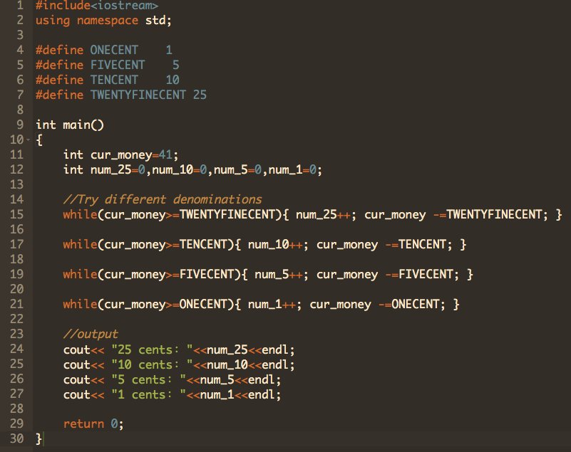
Greedy Algorithm --- Code

Slide 18
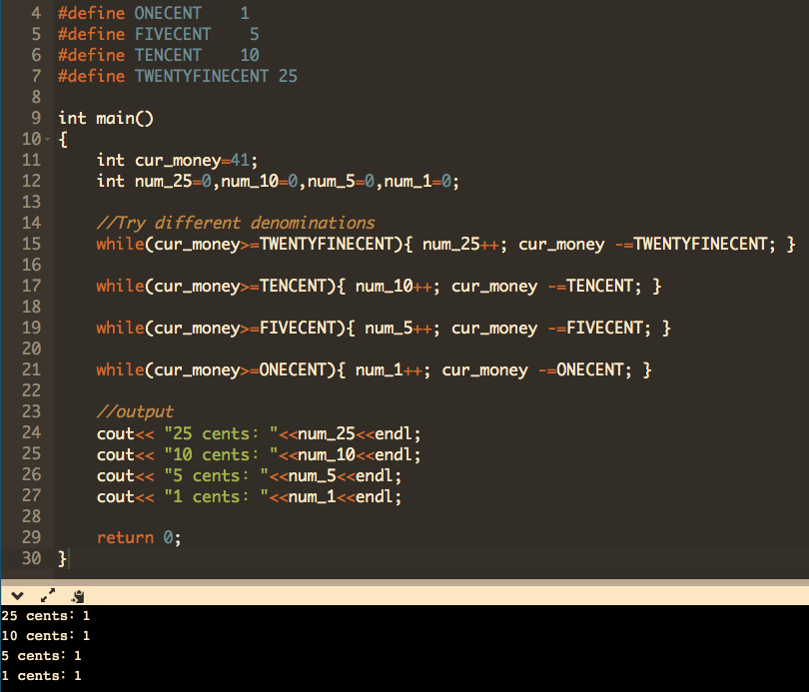

Slide 19
Demo

Slide 20
Hill Climbing Algorithm

Slide 21

Hill Climbing Algorithm

Slide 22
Hill Climbing Algorithm

Slide 23
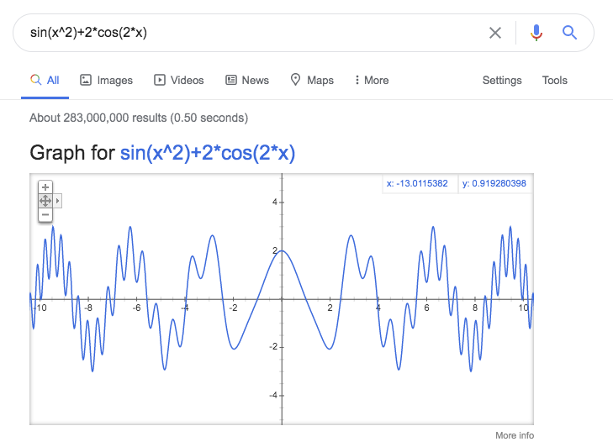
Hill Climbing Algorithm --- An example
Find the maximum value between [5,8].

Slide 24
Demo

Slide 25
Hill Climbing Algorithm
Hill Climbing Algorithm is a greedy algorithm.
A surface with only one maximum. Hill-climbers are well-suited for optimizing over such surfaces, and will converge to the global maximum.

Slide 26
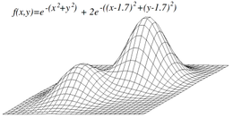
Hill Climbing Algorithm --- Problem
A surface with two local maxima. (Only one of them is the global maximum.) If a hill-climber begins in a poor location, it may converge to the lower maximum.

Slide 27
Simulated Annealing Algorithm

Slide 28
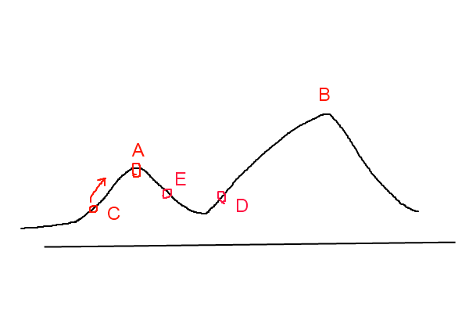
Simulated Annealing Algorithm VS Hill Climbing

Slide 29
Simulated Annealing Algorithm VS Hill Climbing
The hill-climbing method is a completely greedy method. Every time it chooses a current optimal solution which is short-sighted.
Simulated annealing is a greedy algorithm as well, but its search process introduces random factors. The simulated annealing algorithm allows model accept a solution that is worse than the current solution with a certain probability, so it may jump out of this local optimal solution and reach the global optimal solution.

Slide 30
Simulated Annealing Algorithm VS Hill Climbing
Taking the Figure as an example, the simulated annealing algorithm will accept the movement of E with a certain probability after searching for the local optimal solution A. Maybe after a few such moves, point D will be reached, so the local maximum A will be jumped out.

Slide 31
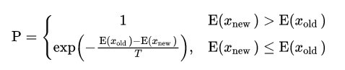
Simulated Annealing Algorithm --- Temperature
1. Get a better solution after moving. Then always accept the move
2. That is, the solution after the move is worse than the current solution, then the move is accepted with a certain probability, and this probability is gradually reduced over time (gradually reduced to stabilize)
The calculation of "a certain probability" here refers to the annealing process of metal smelting, which is the origin of the name of the simulated annealing algorithm. It is calculated according to the principles of thermodynamics.

Slide 32
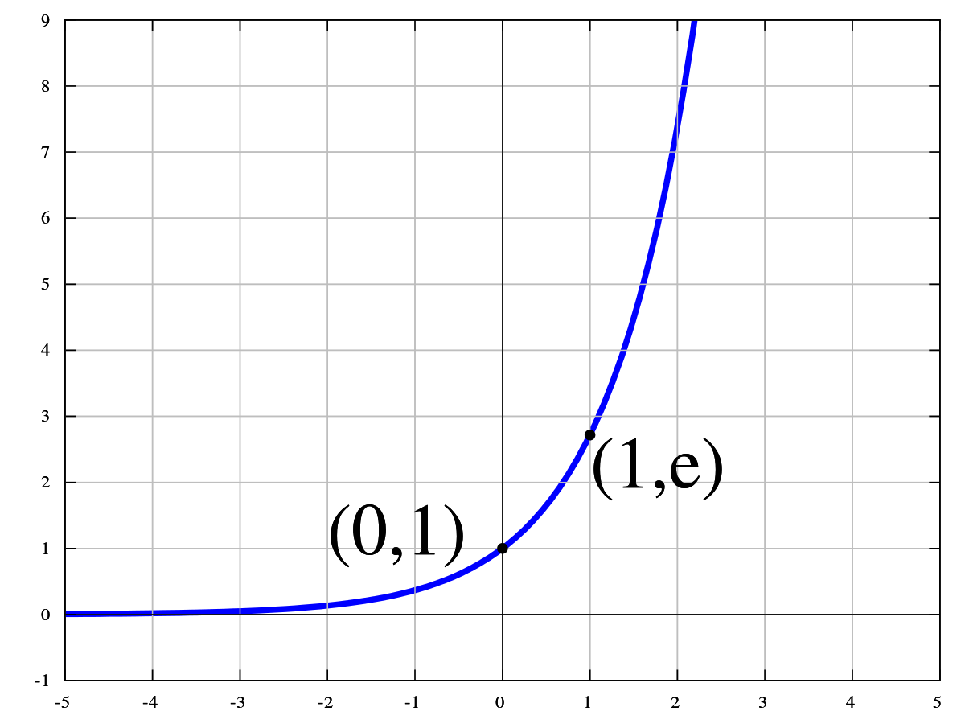
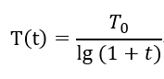
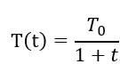
Simulated Annealing Algorithm --- Temperature
It is related to the current temperature parameter T, which decreases with the decrease of temperature.
The classic simulated annealing algorithm:
The fast simulated annealing algorithm:

Slide 33

Simulated Annealing Algorithm
Despite the many local maxima in this graph, the global maximum can still be found using simulated annealing. Unfortunately, the applicability of simulated annealing is problem-specific because it relies on finding lucky jumps that improve the position. In such extreme examples, hill climbing will most probably produce a local maximum.

Slide 34
Ant Colony Optimization Algorithm

Slide 35
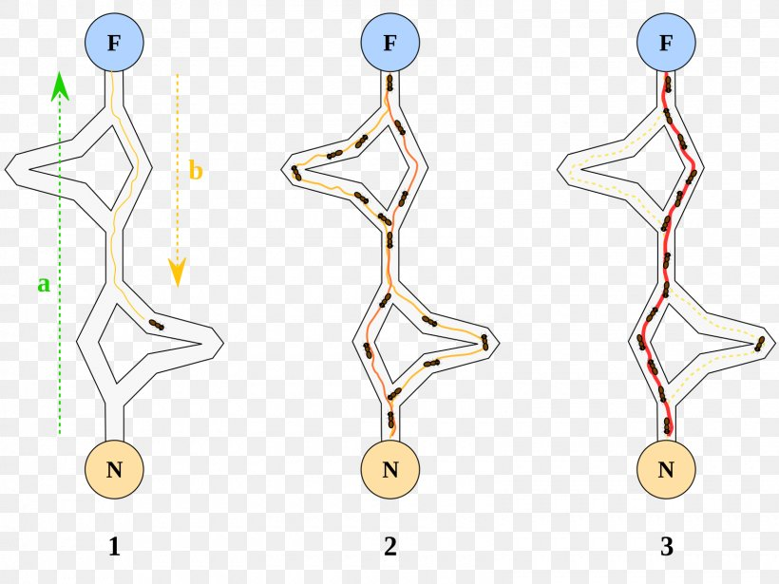
Ant Colony Optimization Algorithm
Individual ant acts with randomness;
but there are patterns in colony actions

Slide 36
Ant Colony Optimization Algorithm
Invented by Italian scientist Marco Dorigo in 1992

Slide 37
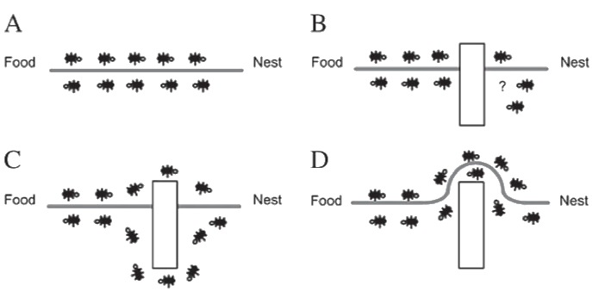
Ant Colony Optimization Algorithm
Pheromone Tracking: following routes with strong pheromone within a certain probability
Pheromone residue: leave pheromone behind. These pheromone will fade away with time. The closer an ant to the food, the more Pheromone will be released.

Slide 38
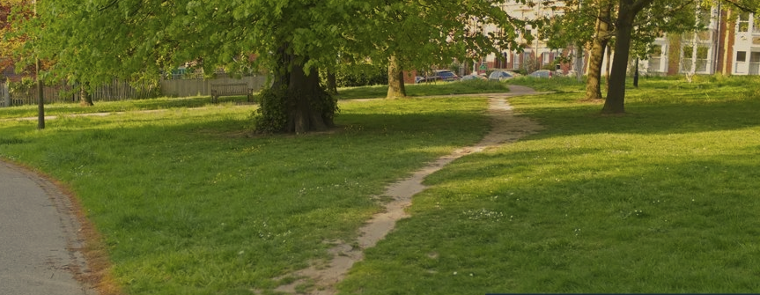
Ant Colony Optimization Algorithm

Slide 39
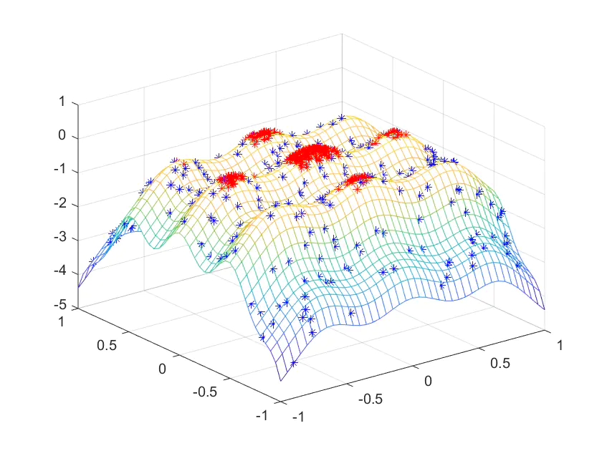
Ant Colony Optimization Algorithm

Slide 40
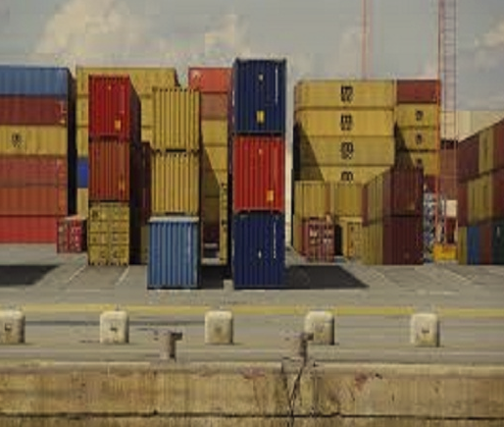
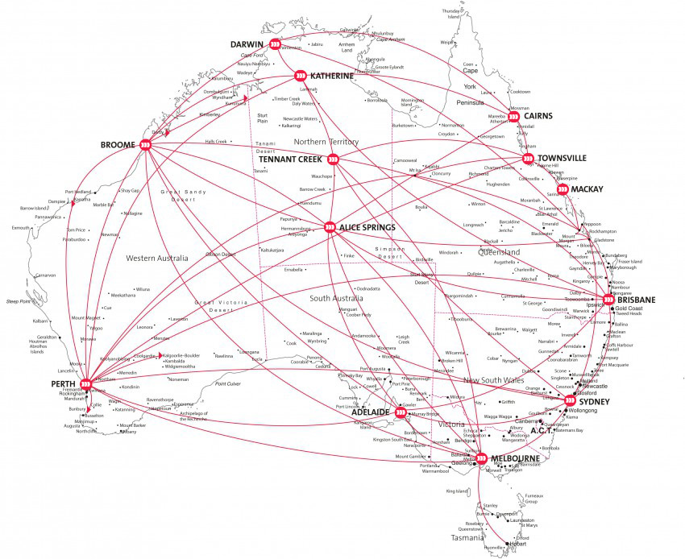
Ant Colony Optimization Algorithm

Slide 41
Reference
Greedy algorithm
https://en.wikipedia.org/wiki/Greedy_algorithm
Hill climbing & Simulated annealing
https://en.wikipedia.org/wiki/Hill_climbing
Ant colony optimization algorithms
https://en.wikipedia.org/wiki/Ant_colony_optimization_algorithms

